Slide 1


The Last Cyborgian Plant
Progress Report 3
Jie Guan

Slide 2
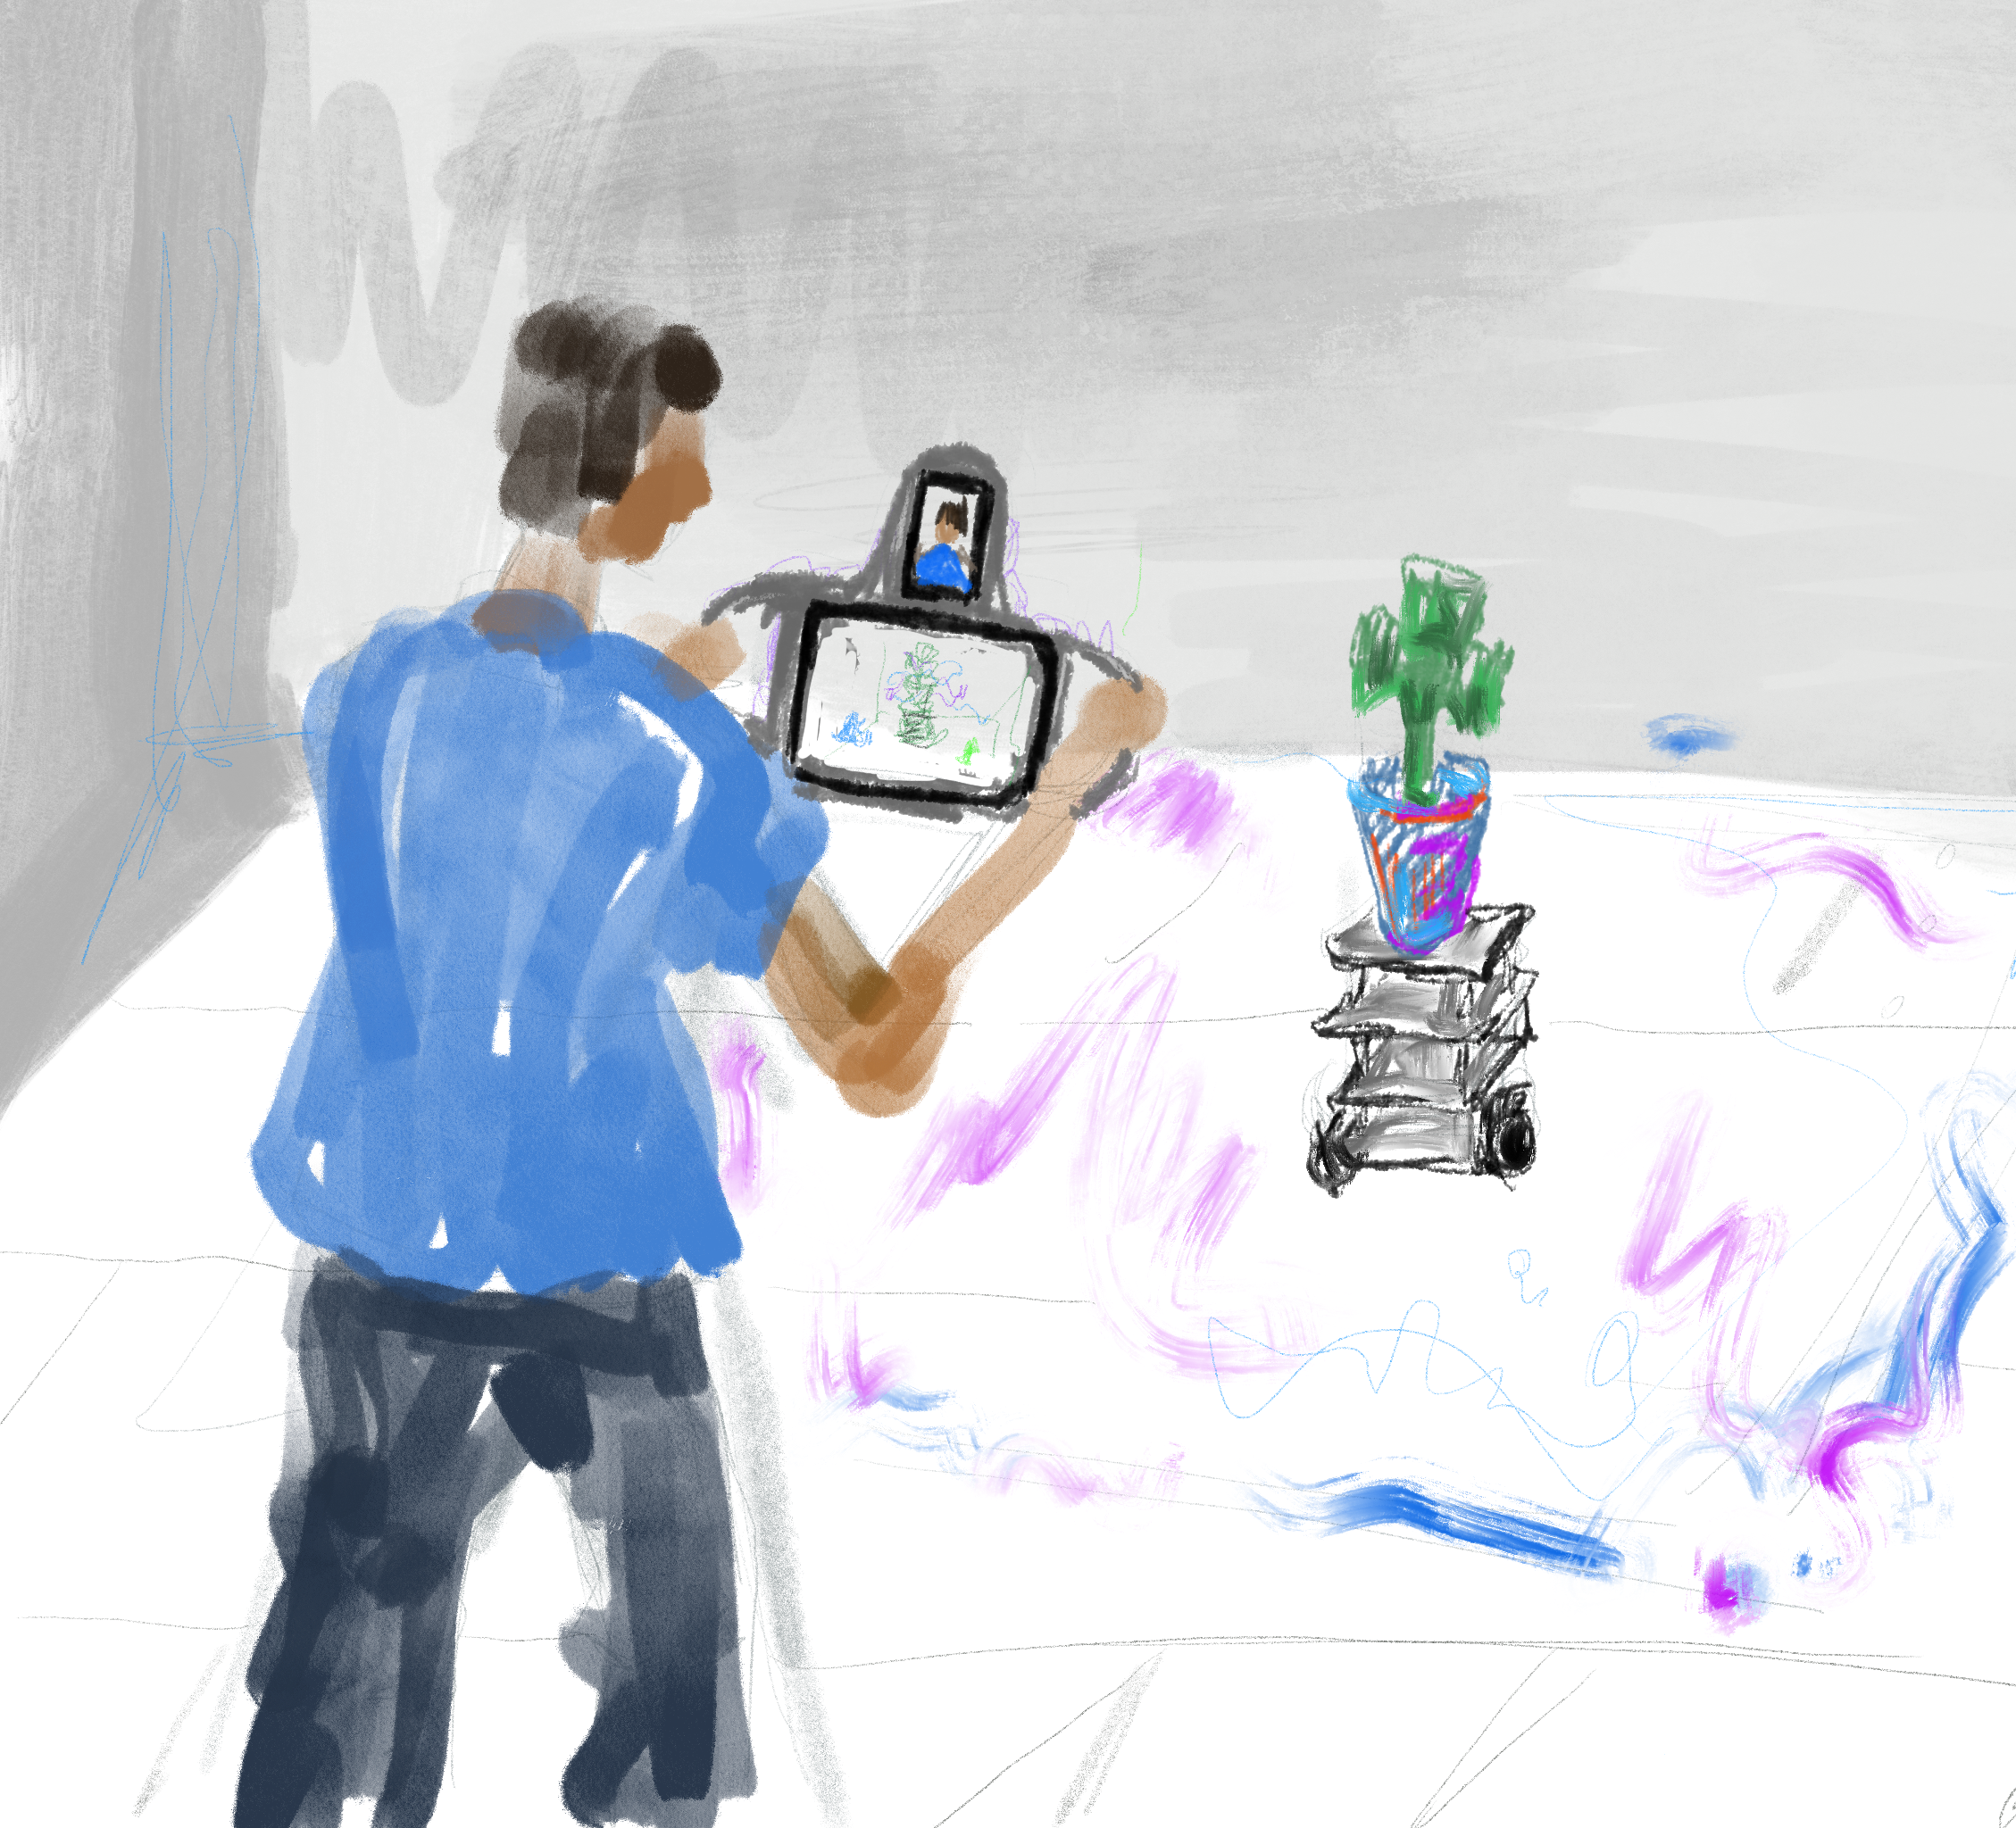
A sentence to describe my work
An interactive installation object cyborg plants (the combination of organism and robot) running on the space, audiences can view and interact with the hybrid virtual content applying to the environment and the cyborg object through a custom device and apps.

Slide 3
The Topic I Want To Explore On This Project
Explore hybrid physical and virtual object through a cyborg plant.
The imagination of the future human with machine, networking, and virtual content.
The interface between human and machine on the space with the AR devices and the robot.
The context of how machine implicate in cyberspace.

Slide 4
What I Did on Last Semester, Report 1 & 2

Slide 5
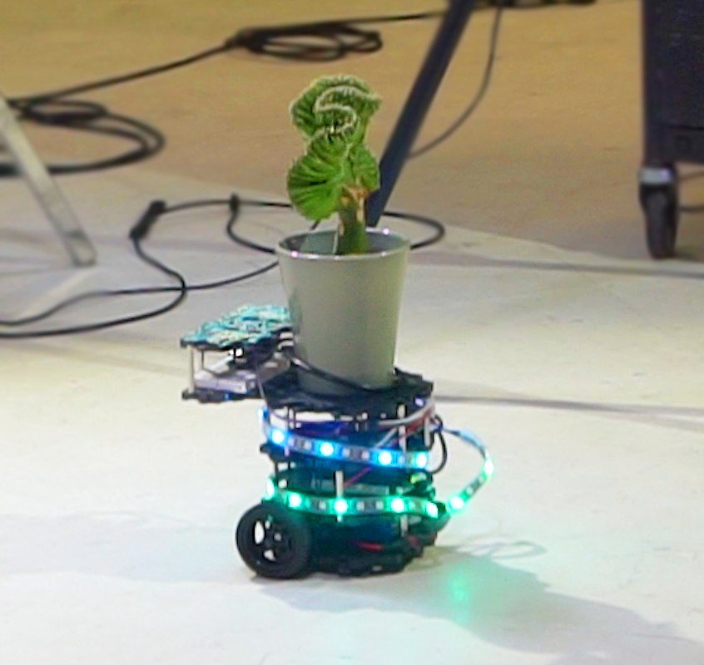
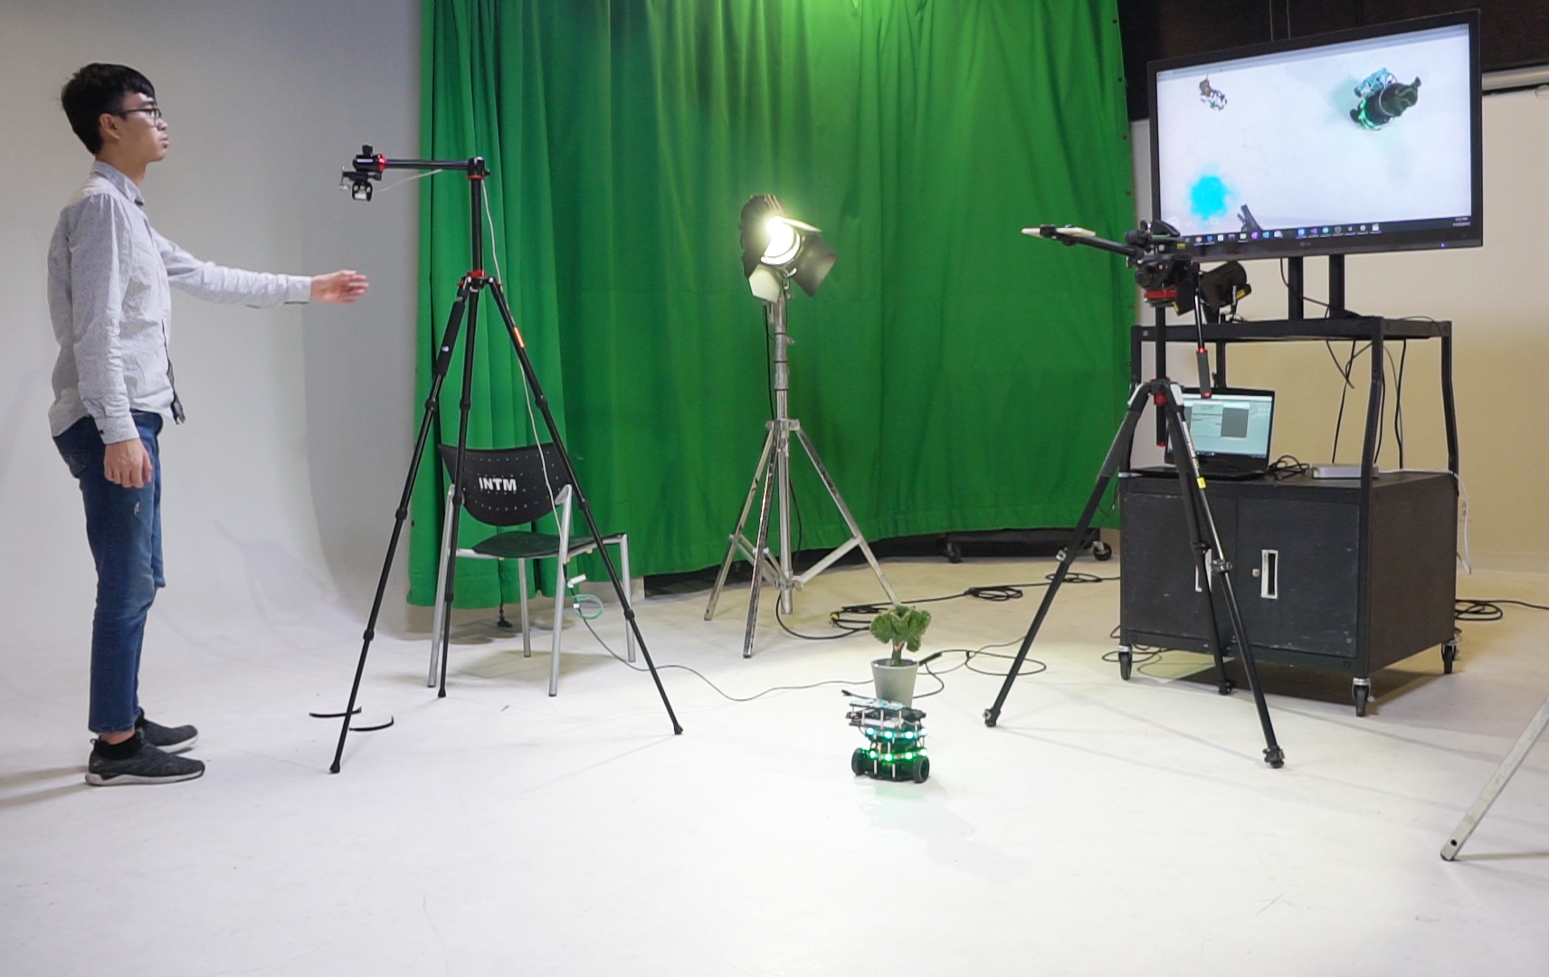
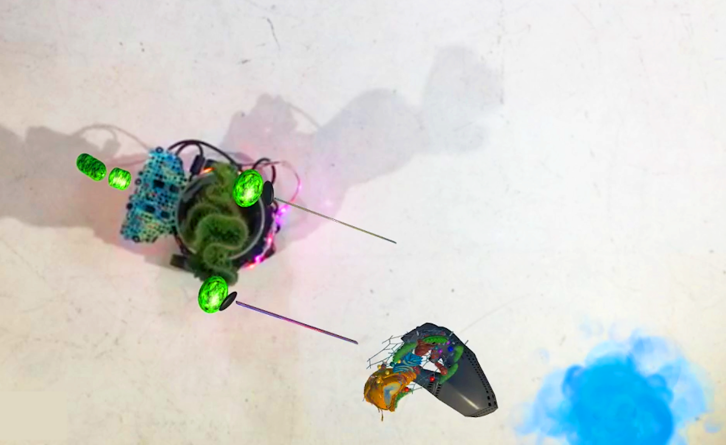

Slide 6
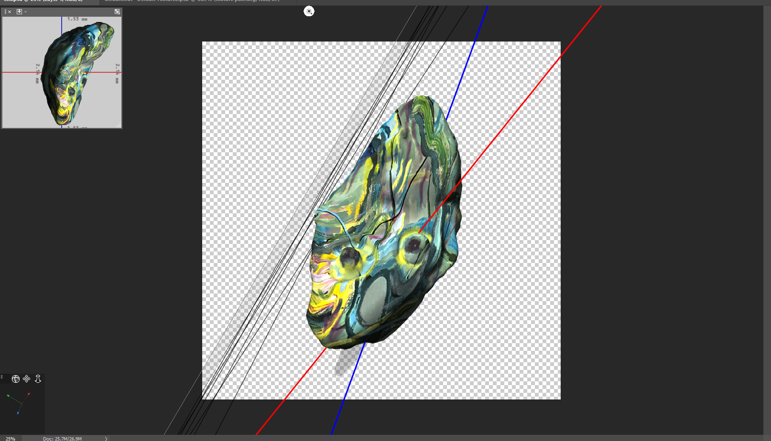
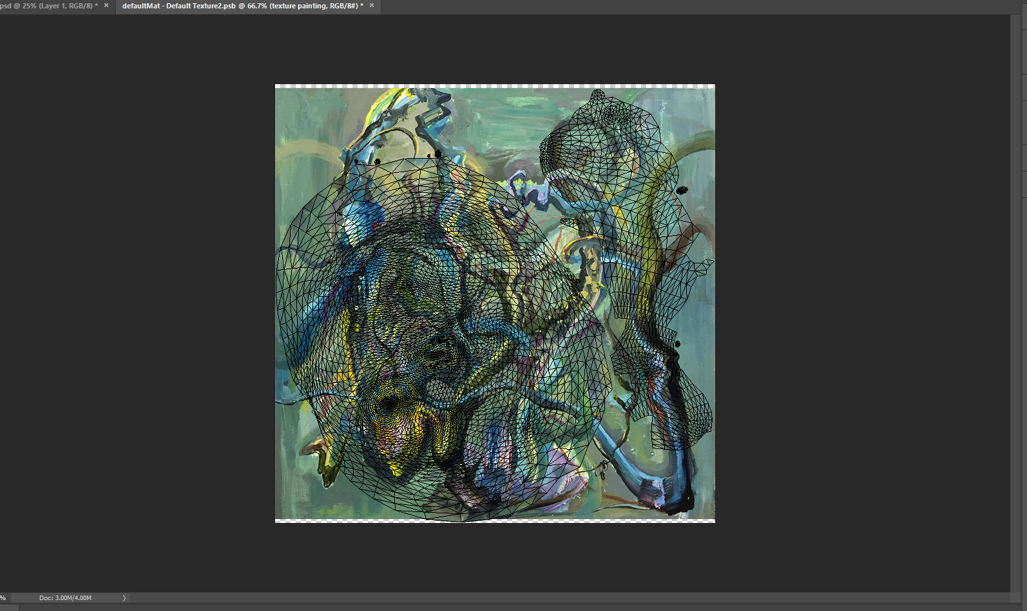
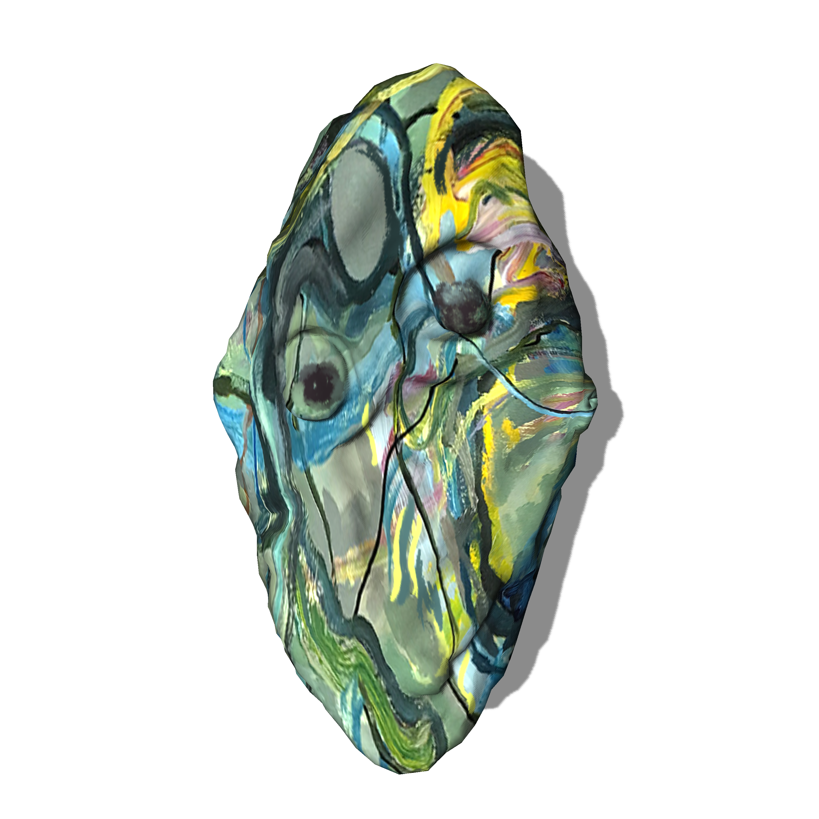
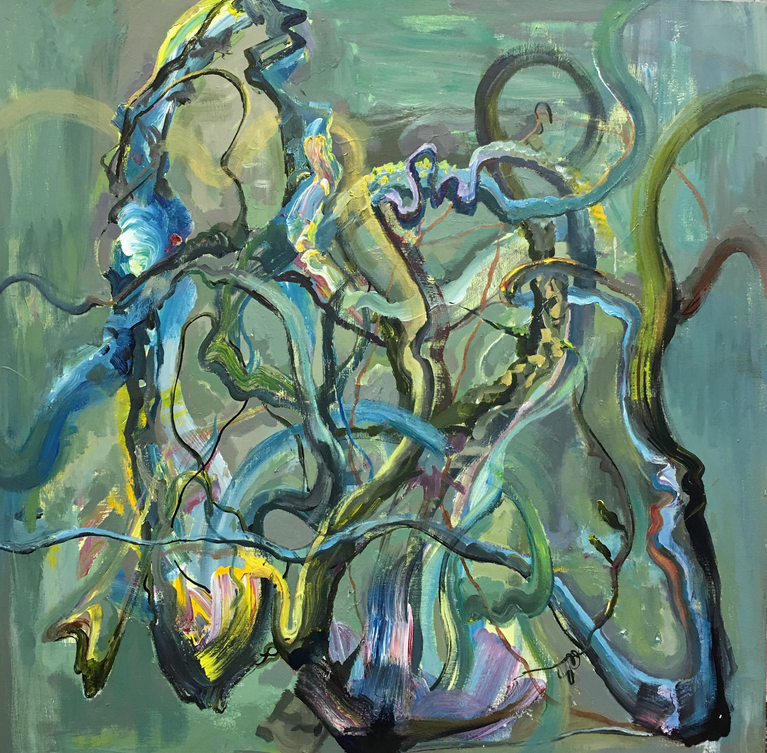
Texturing

Slide 7
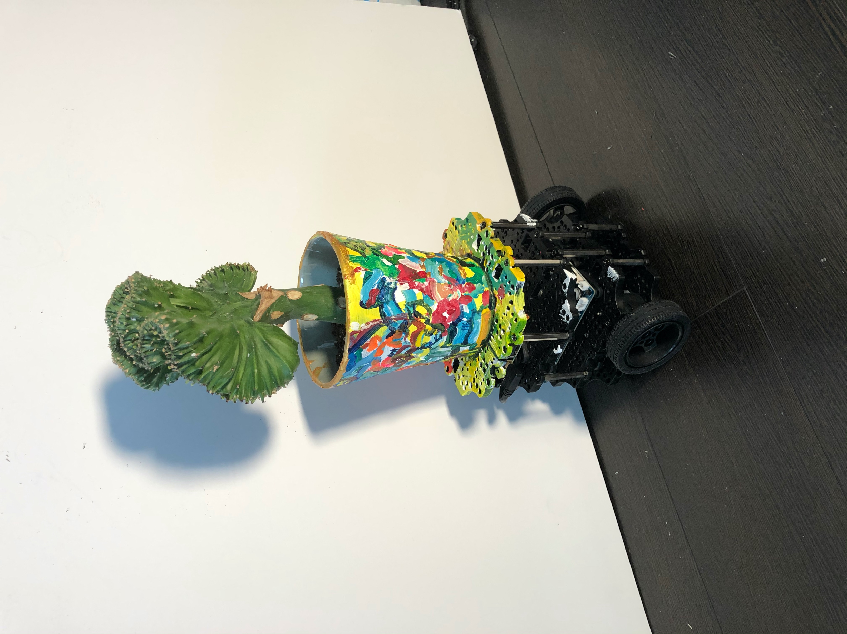
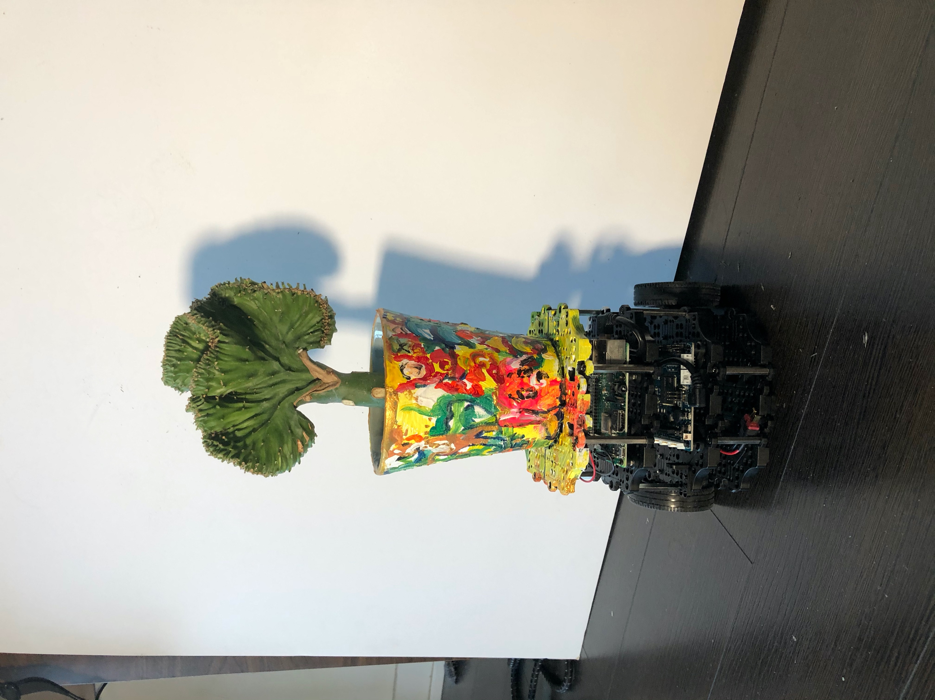
Applying Painterly Texture to the Cyborg Object

Slide 8
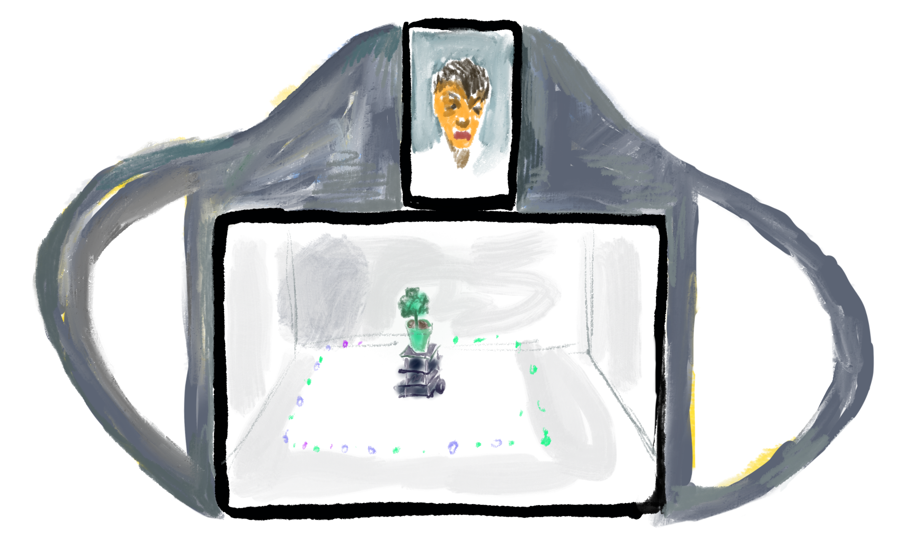
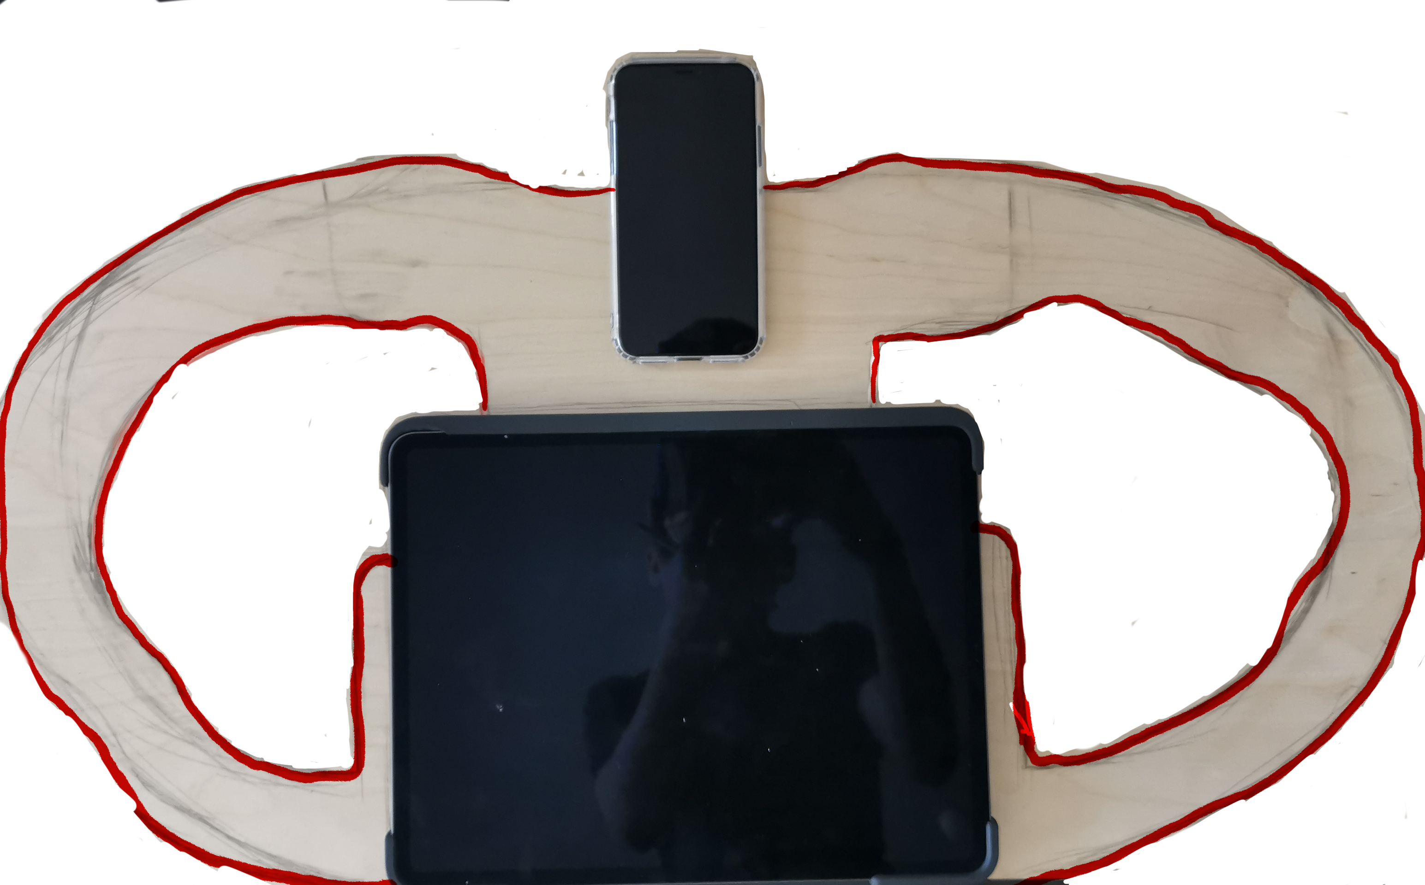
Color plastic
Children MIKA
The Combination of Hardware Design
This will be fabricated by laser cut

Slide 9
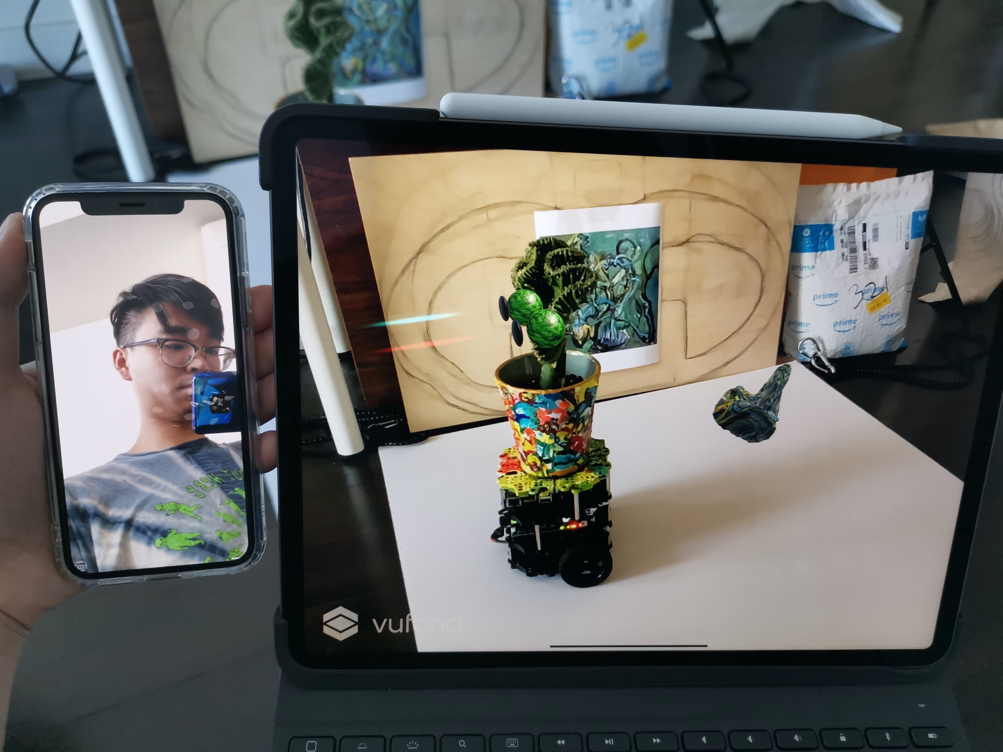
View on the devices

Slide 10
The work on Report 3

Slide 11
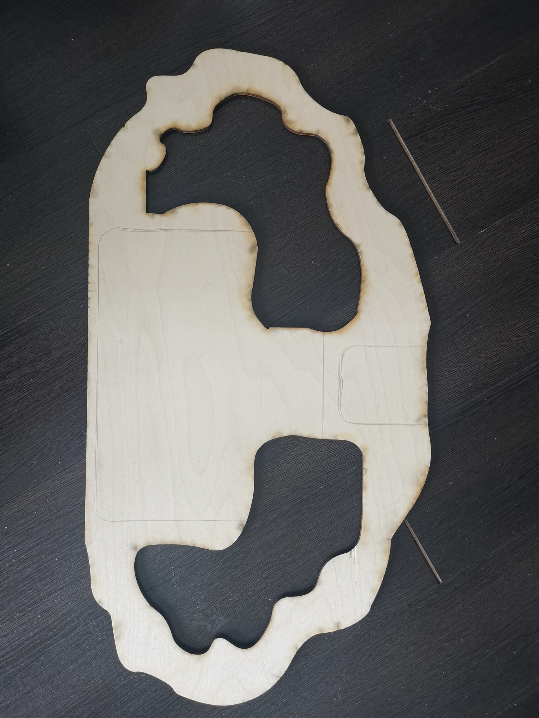
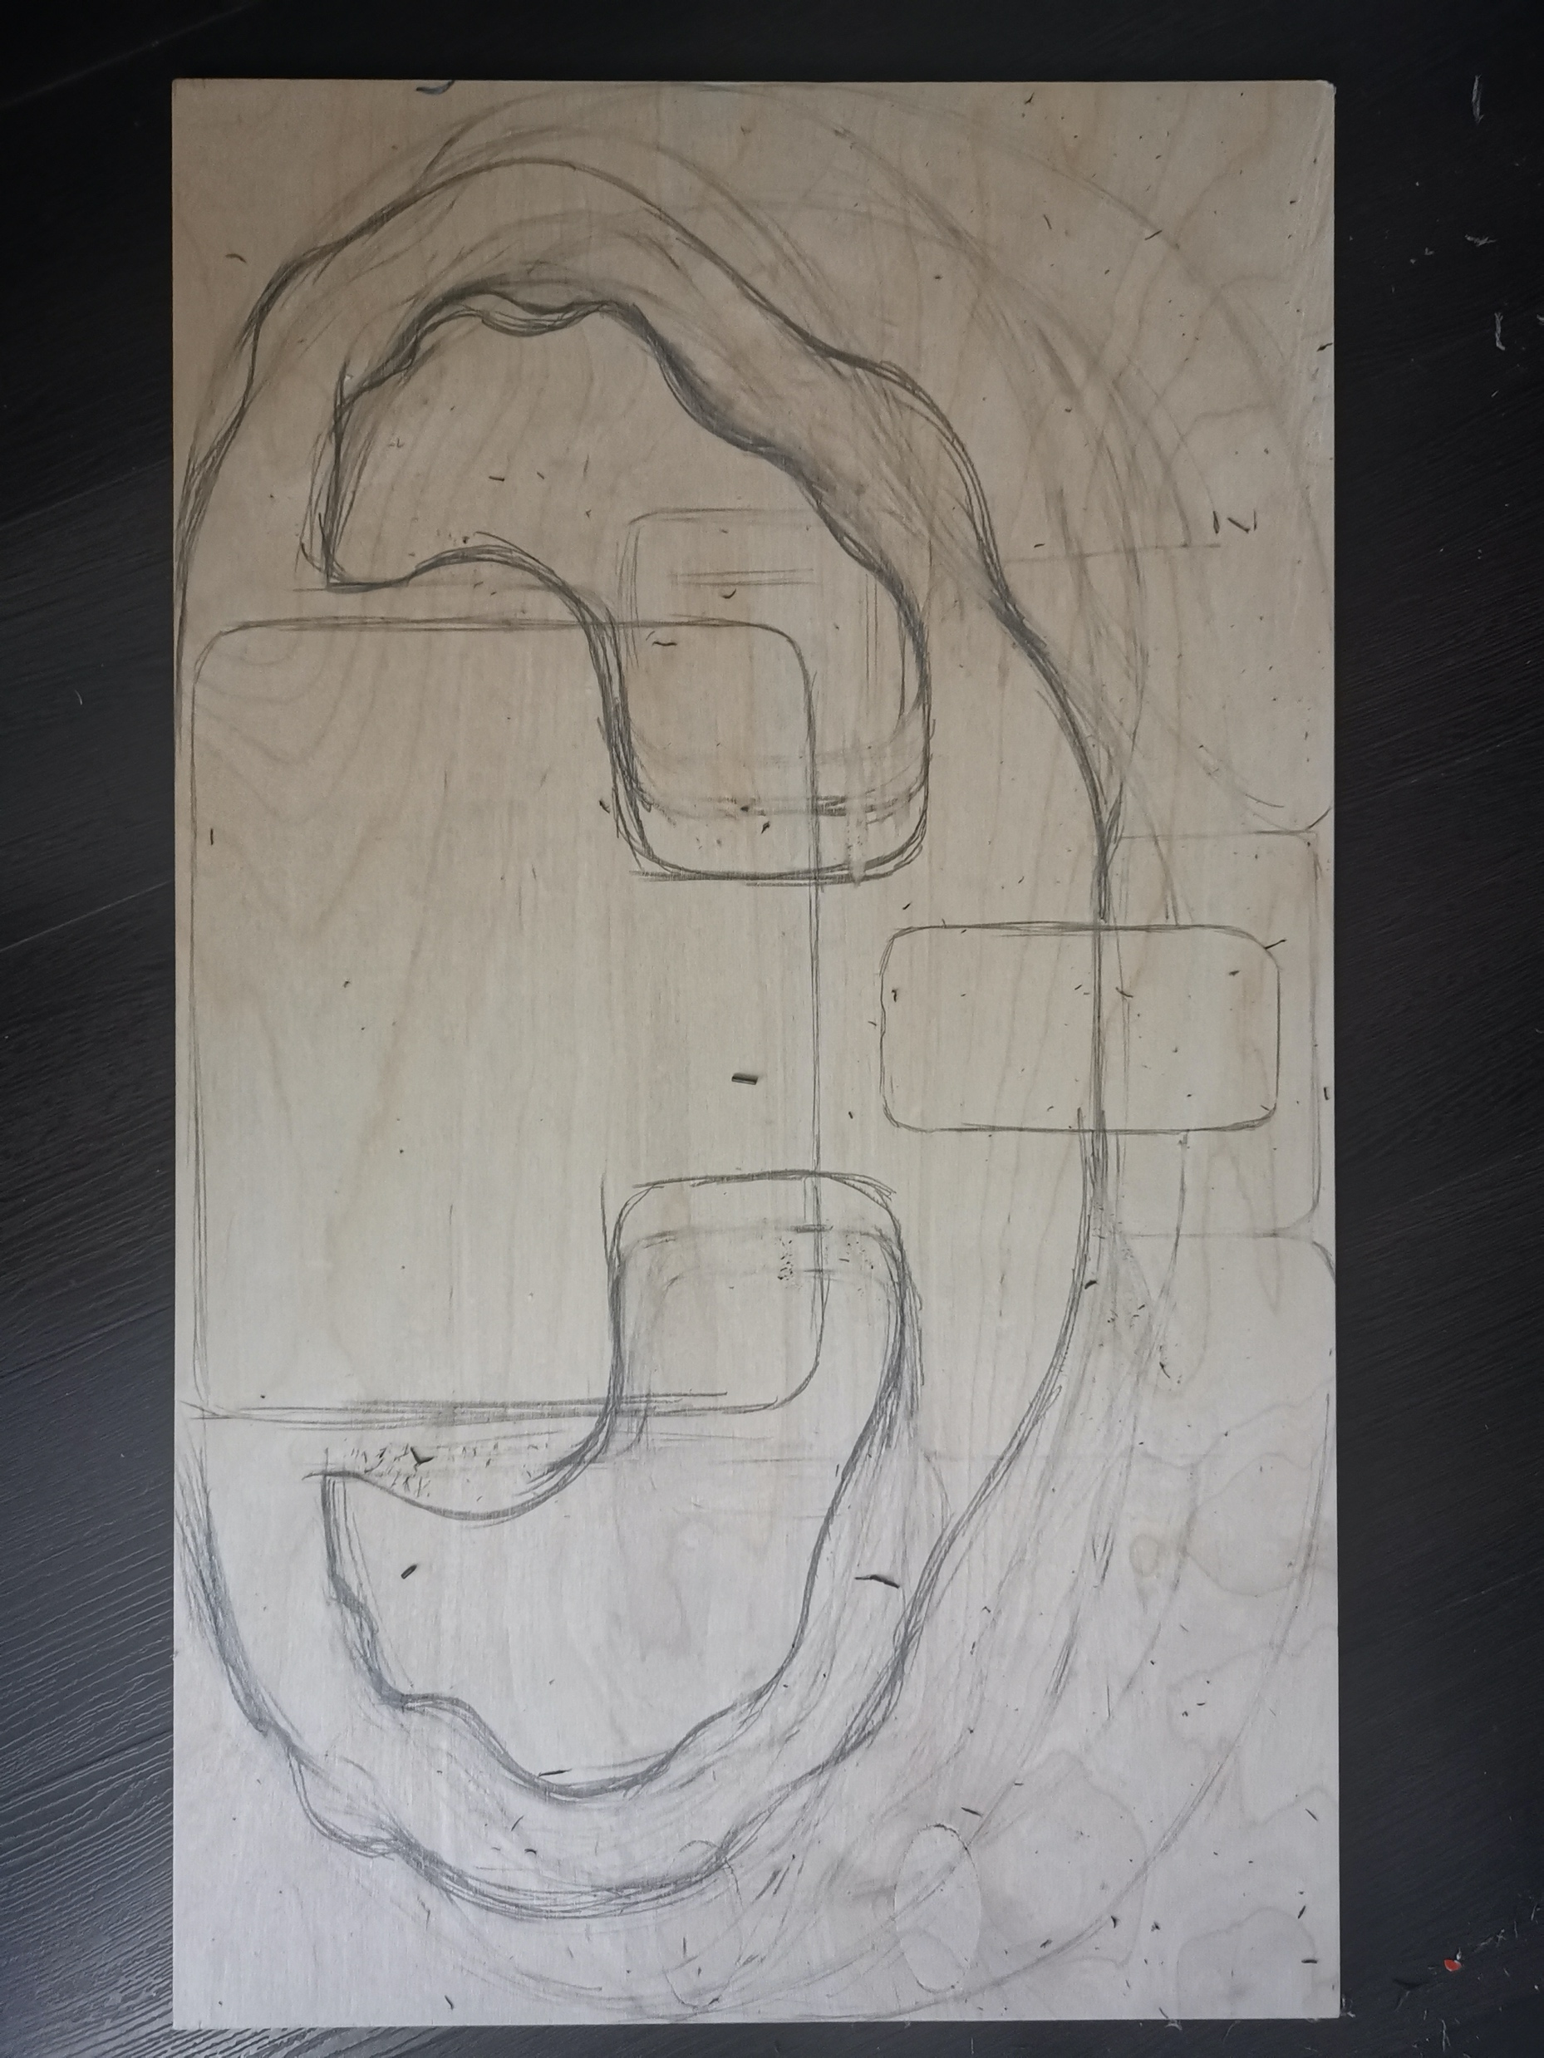
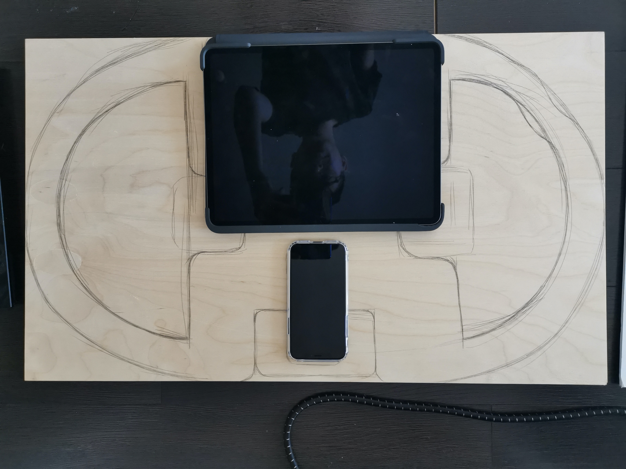

Slide 12
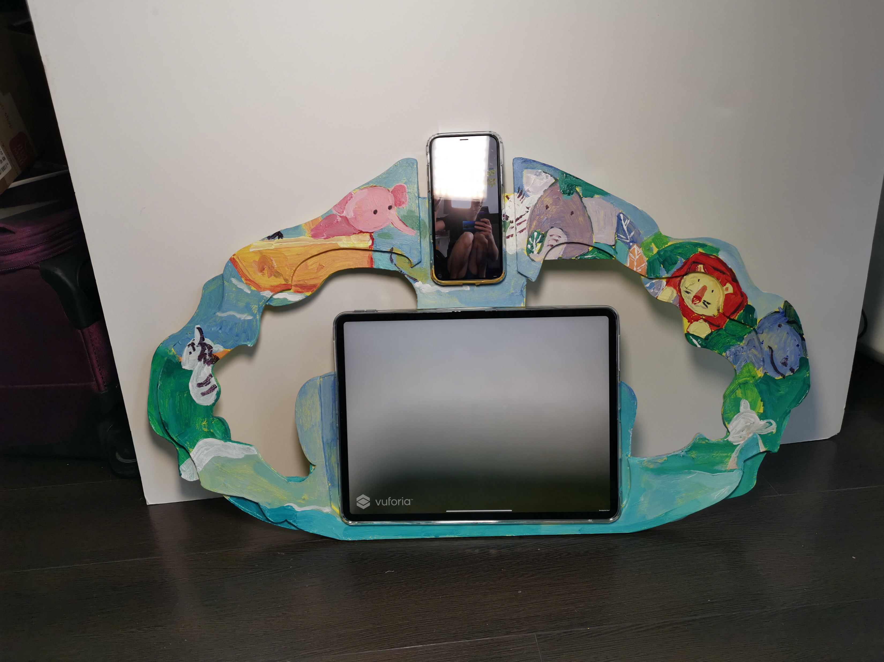
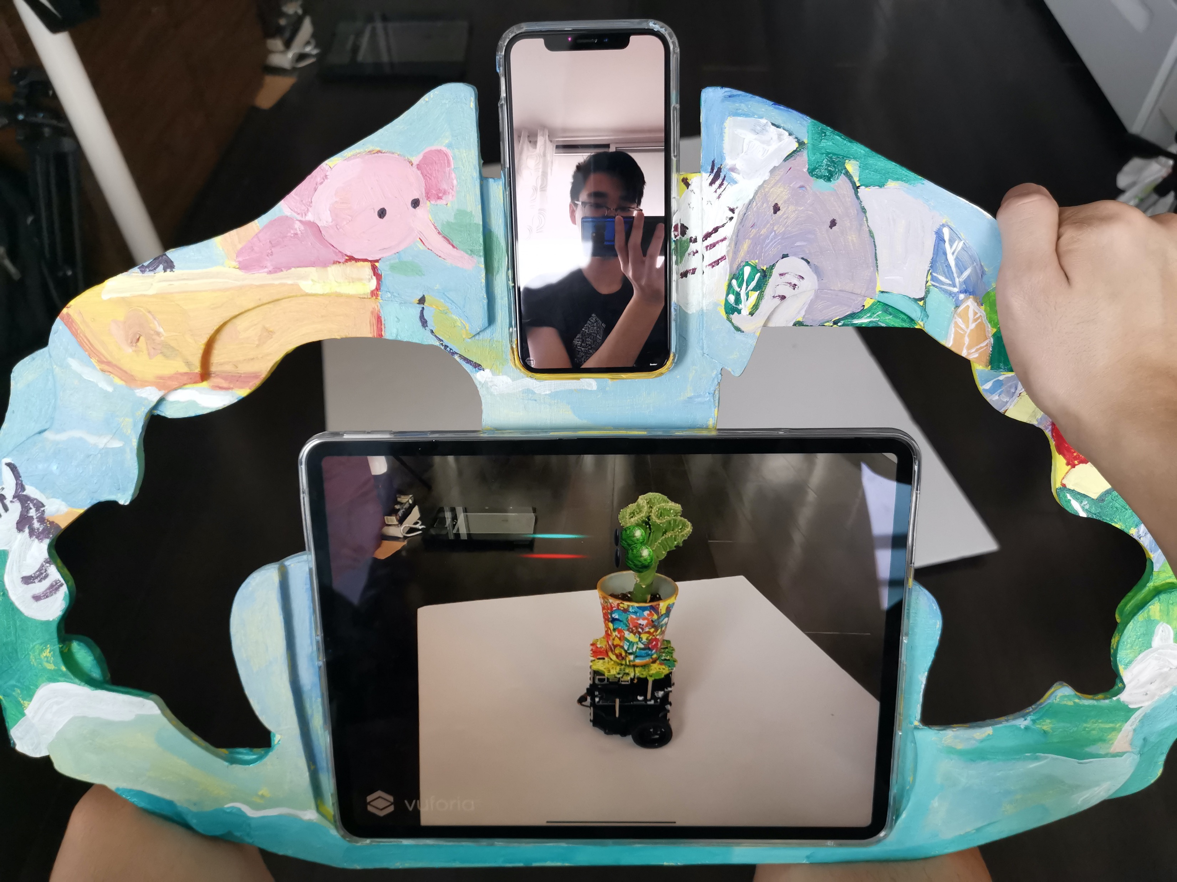
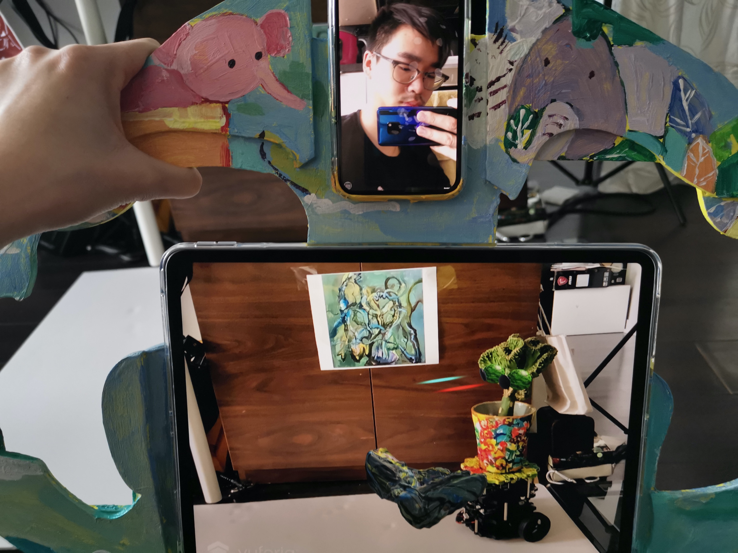

Slide 13
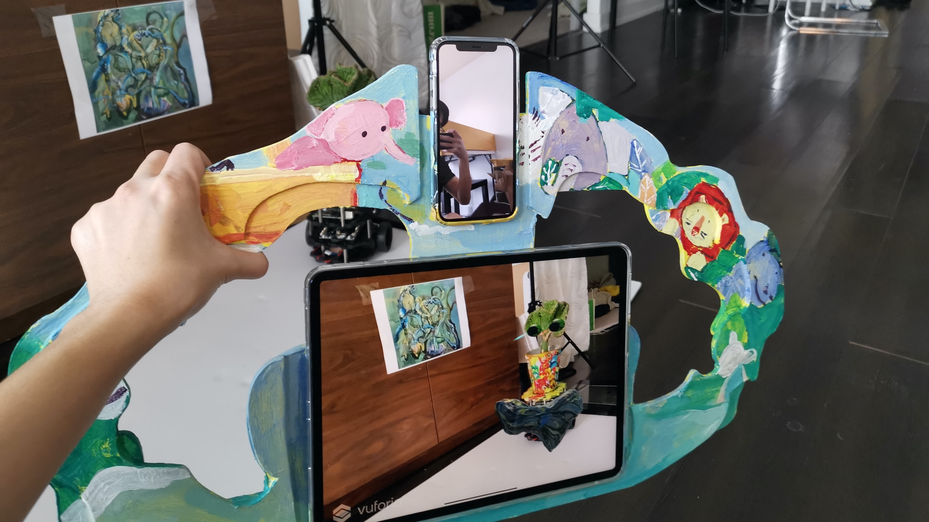

Slide 14
Thank you

